Slide 1

iCuse Consultants:
Hotel cancellation Analysis
Anjali Shahi
Pranali Shenvi
Kirat Saran
Anusha Ramprasad
Jacob Murrer

Slide 2

Introduction
Guests are the source of revenue for a hotel.
As the frequency of booking cancellations grows, this revenue falls.
As consultants, our goal is to figure out why bookings are canceled.
We examined the hotel's booking data and ran an analysis to determine which factors influence cancellations.
If we can properly target the issues, we will be able to reduce cancellations and improve revenue.

Slide 3



Objectives
To find out the conditions that are influencing hotel reservation cancelations by guests.
To predict which guest is going to cancel a booking based on various factors.
To recommend possible solutions to the hotel management in order to increase revenue.

Slide 4
Business Questions
Does opting for RequiredParkingSpace while making hotel reservations impact cancellations?
Is it possible to associate meal plans and StaysinWeeknights with possible hotel booking cancellations?
Which market segment influences the cancellations the most?
Does DepositType affect cancellations?
Are customers making cancellations based on the rooms they were assigned?
Are customers who have made special requests while making hotel reservations less likely to cancel?

Slide 5


Initial Descriptive Analysis

Slide 6
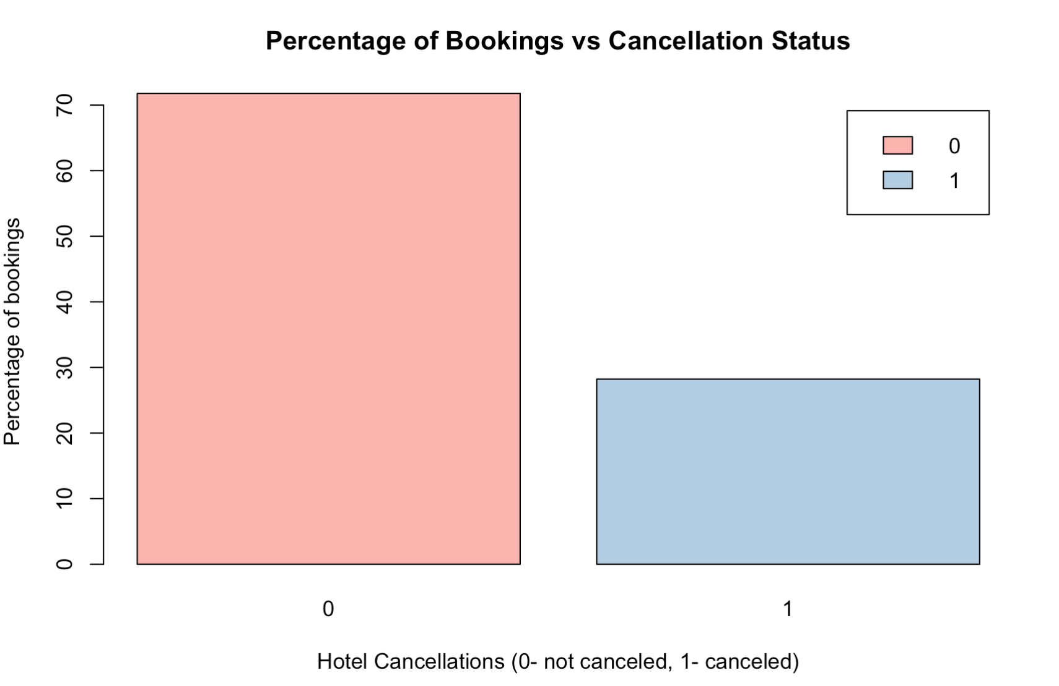
What is the relative percentage of canceled & non-canceled bookings?

Slide 7
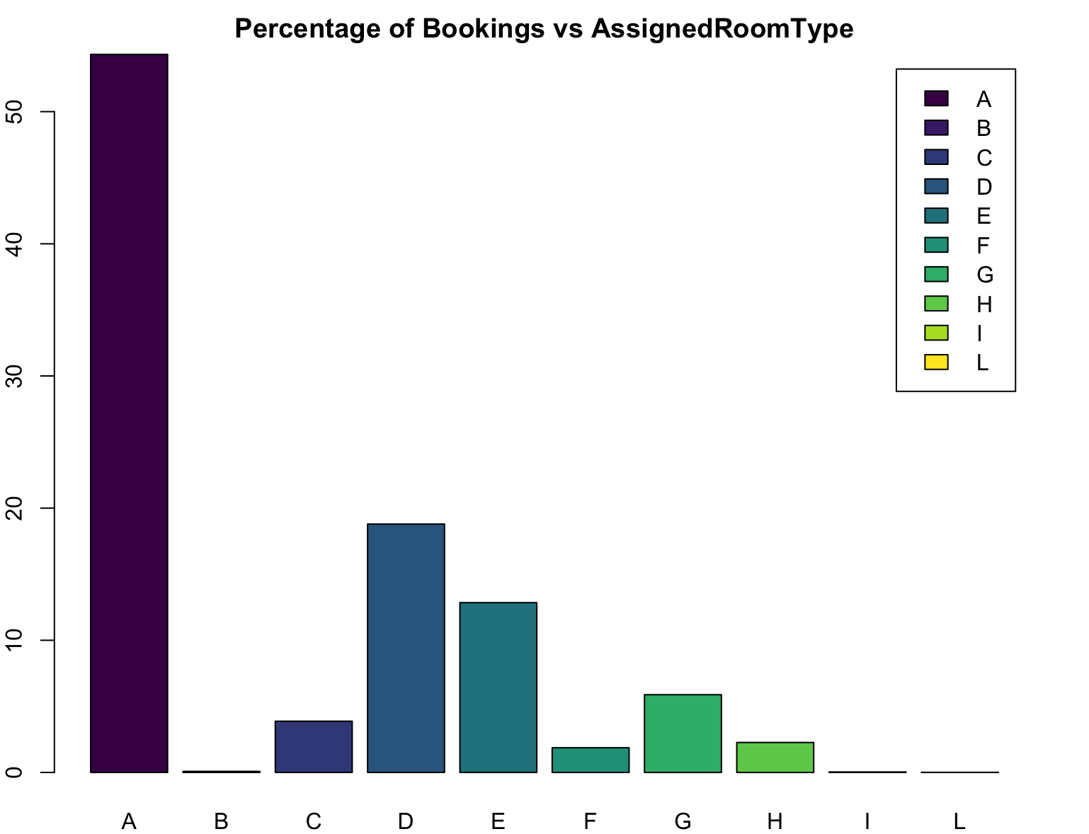
How are cancelled bookings related to room type?

Slide 8
How are cancelations distributed by Market segments?

Slide 9
Focusing on canceled bookings, how are weekend and week stays distributed by market segments?

Slide 10
How are cancelations distributed by Types of meals?

Slide 11
Focusing on canceled bookings, how are weekend and week stays distributed by Types of meals?

Slide 12
How are cancelations distributed by Deposit type?

Slide 13
Focusing on canceled bookings, how are weekend and week stays distributed by Deposit Types?

Slide 14
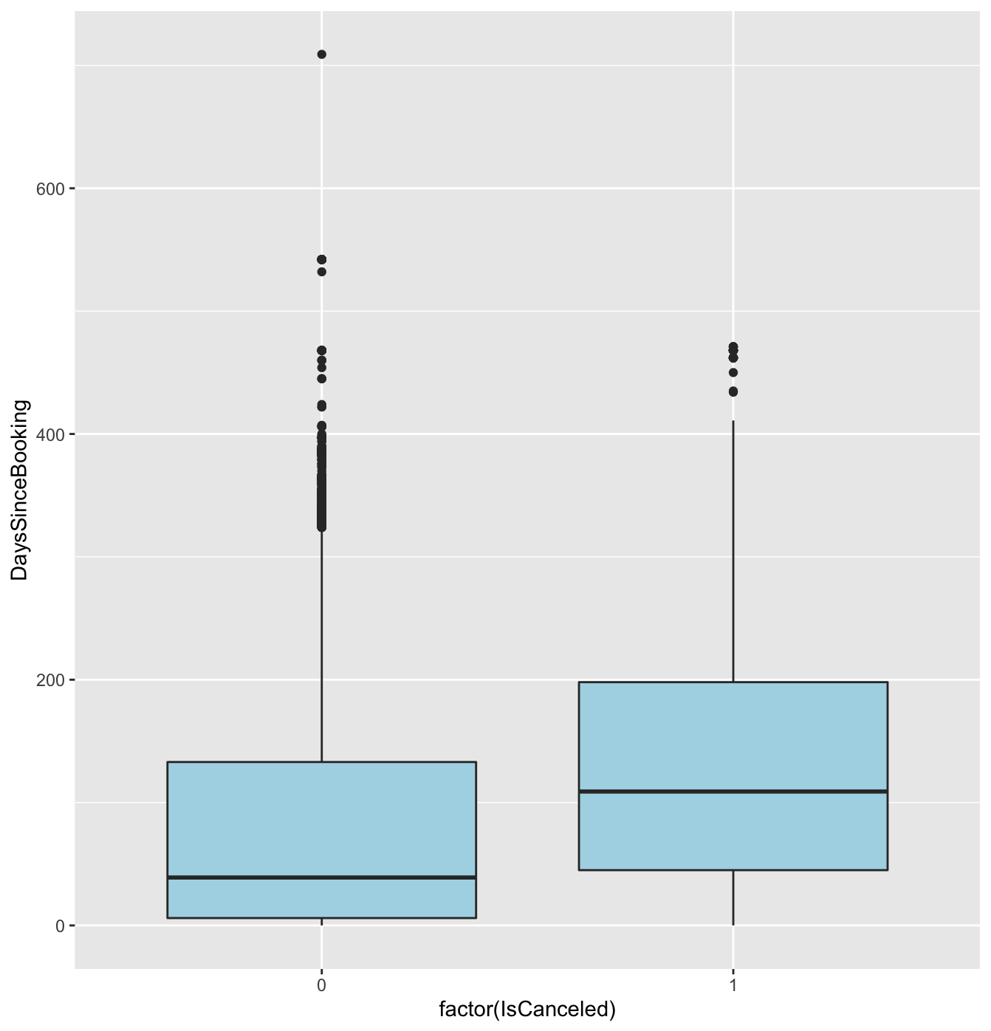
Do cancellations depend upon the difference between booking and check-in dates?

Slide 15
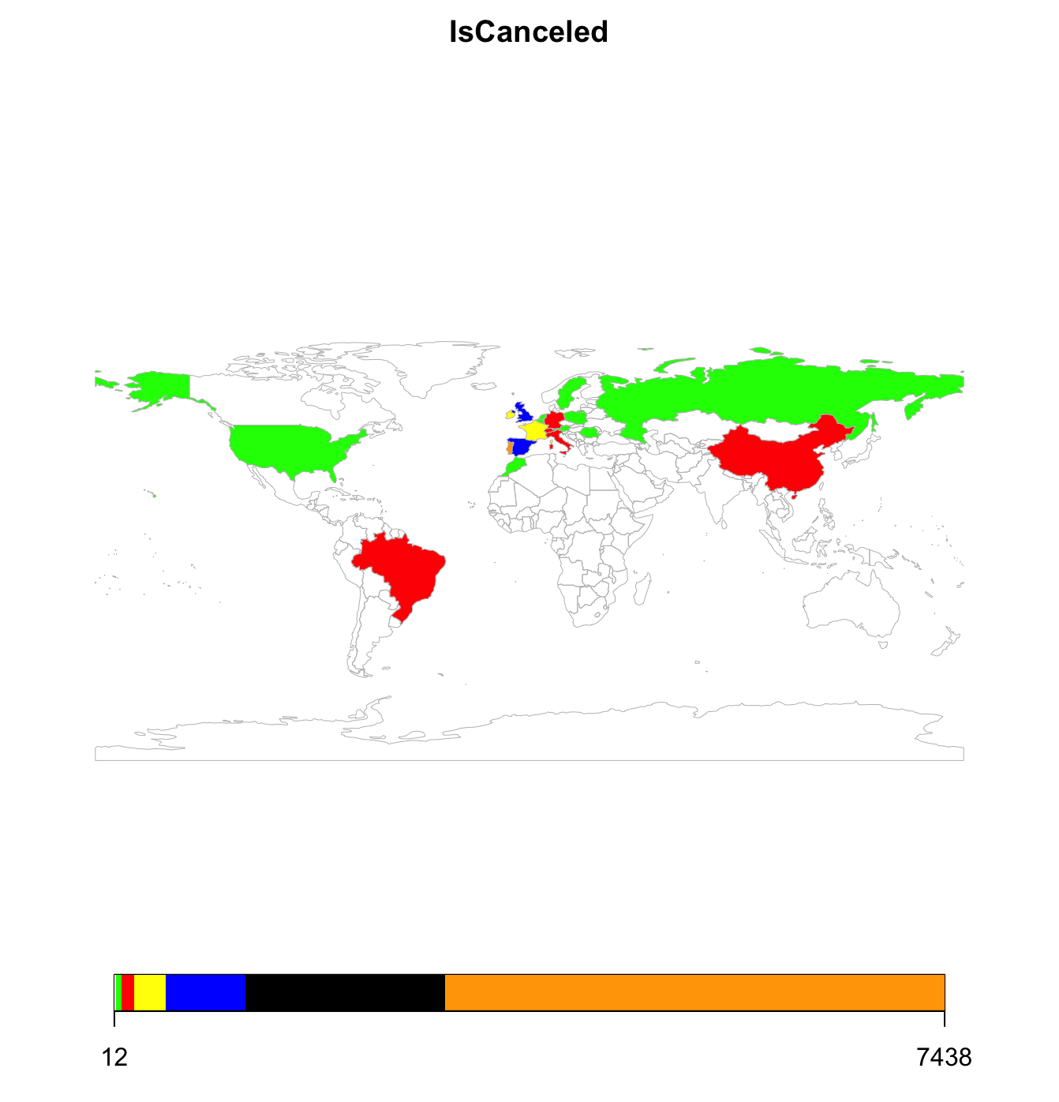
How are the booking cancellations distributed across various countries?

Slide 16

Analysis: Modeling techniques

Slide 17
Logistic Regression: Significant variables
DaysSinceBooking
StaysinWeekendnights
PreviousCancellations
BookingChanges
TotalofspecialRequests
MarketSegment
CustomerType
DepositType
Meal
ReservedRoomType

Slide 18
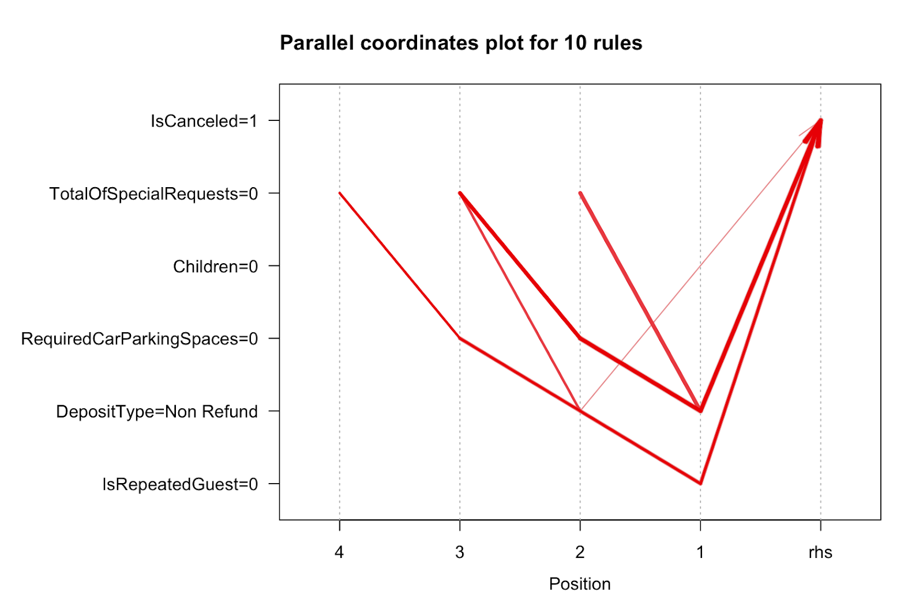
Association rules Mining: Possible rules for hotel cancellations

Slide 19
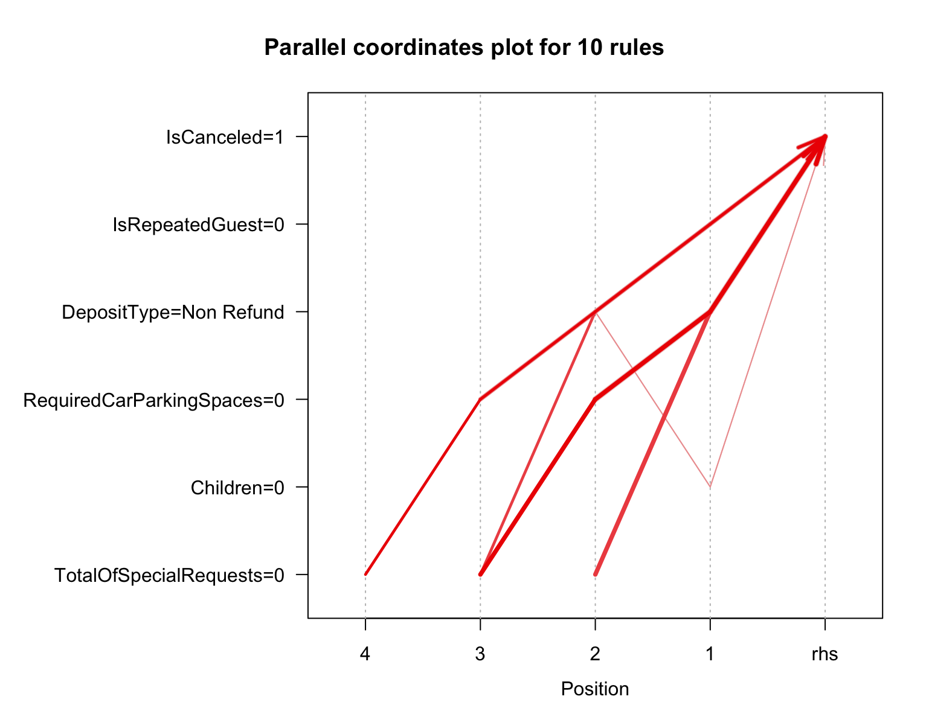
Possible rules for hotel cancellations - 2

Slide 20
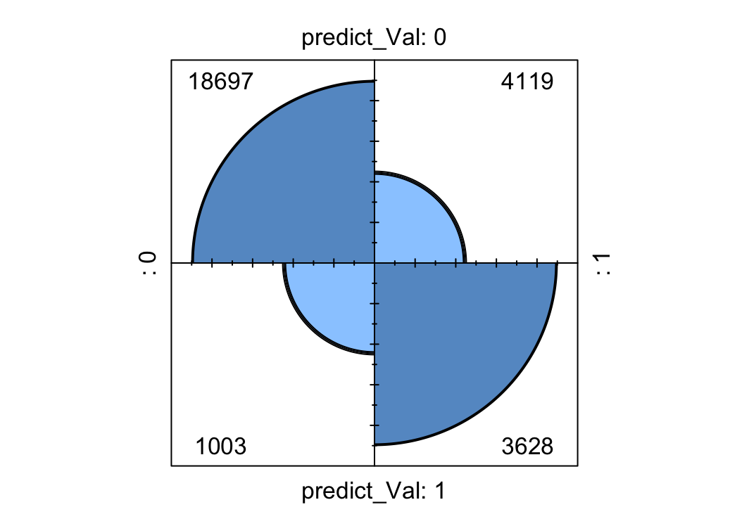
Support Vector Machines with accuracy (81.34%):

Slide 21



Insights and Recommendations
Category
Insights
Recommendations
Large no. of cancellations on BB and HB meals
Observed more in Weekend bookings
Creation of loyalty programs on BB and HB bookings
Separate or combined programs for weekend bookings
Guest Retention
More cancellations observed for no deposit bookings
More cancellations on Non-refundable than Refundable bookings
Nominal amount must be paid as deposit for booking
Deposit also adds to the loyalty points
Payment structure
Out of all the Market segments, groups have larger relative cancellations
Similar situation with complementary
Encourage bigger groups to avail more discount
Revenue still goes up and bigger groups are attracted
Market Segments

Slide 22


